Slide 1


Renton Fish and Game Club
USPSA
Trigger Treat - Oktober 2021
Match Booklet

Slide 2
Stage 1 A Tale of Three Windows Course Designer: Marcel Englmaier
A Tale of Three Windows is a 21 round, 105 point Comstock Long course. There are 10 USPSA targets and 1 steel target. The best two hits per target will score. Steel must fall to score. The start signal is audible.
The Handgun start position is standing with heels touching either set of marks and wrists below belt. Handgun loaded and holstered. The PCC start position is standing with heels touching either set of marks. PCC loaded with stock touching belt and muzzle pointed down range.
On the audible start signal, engage all targets from within the shooting area. Knockdown steel closes center window and opens outer windows.

Slide 3
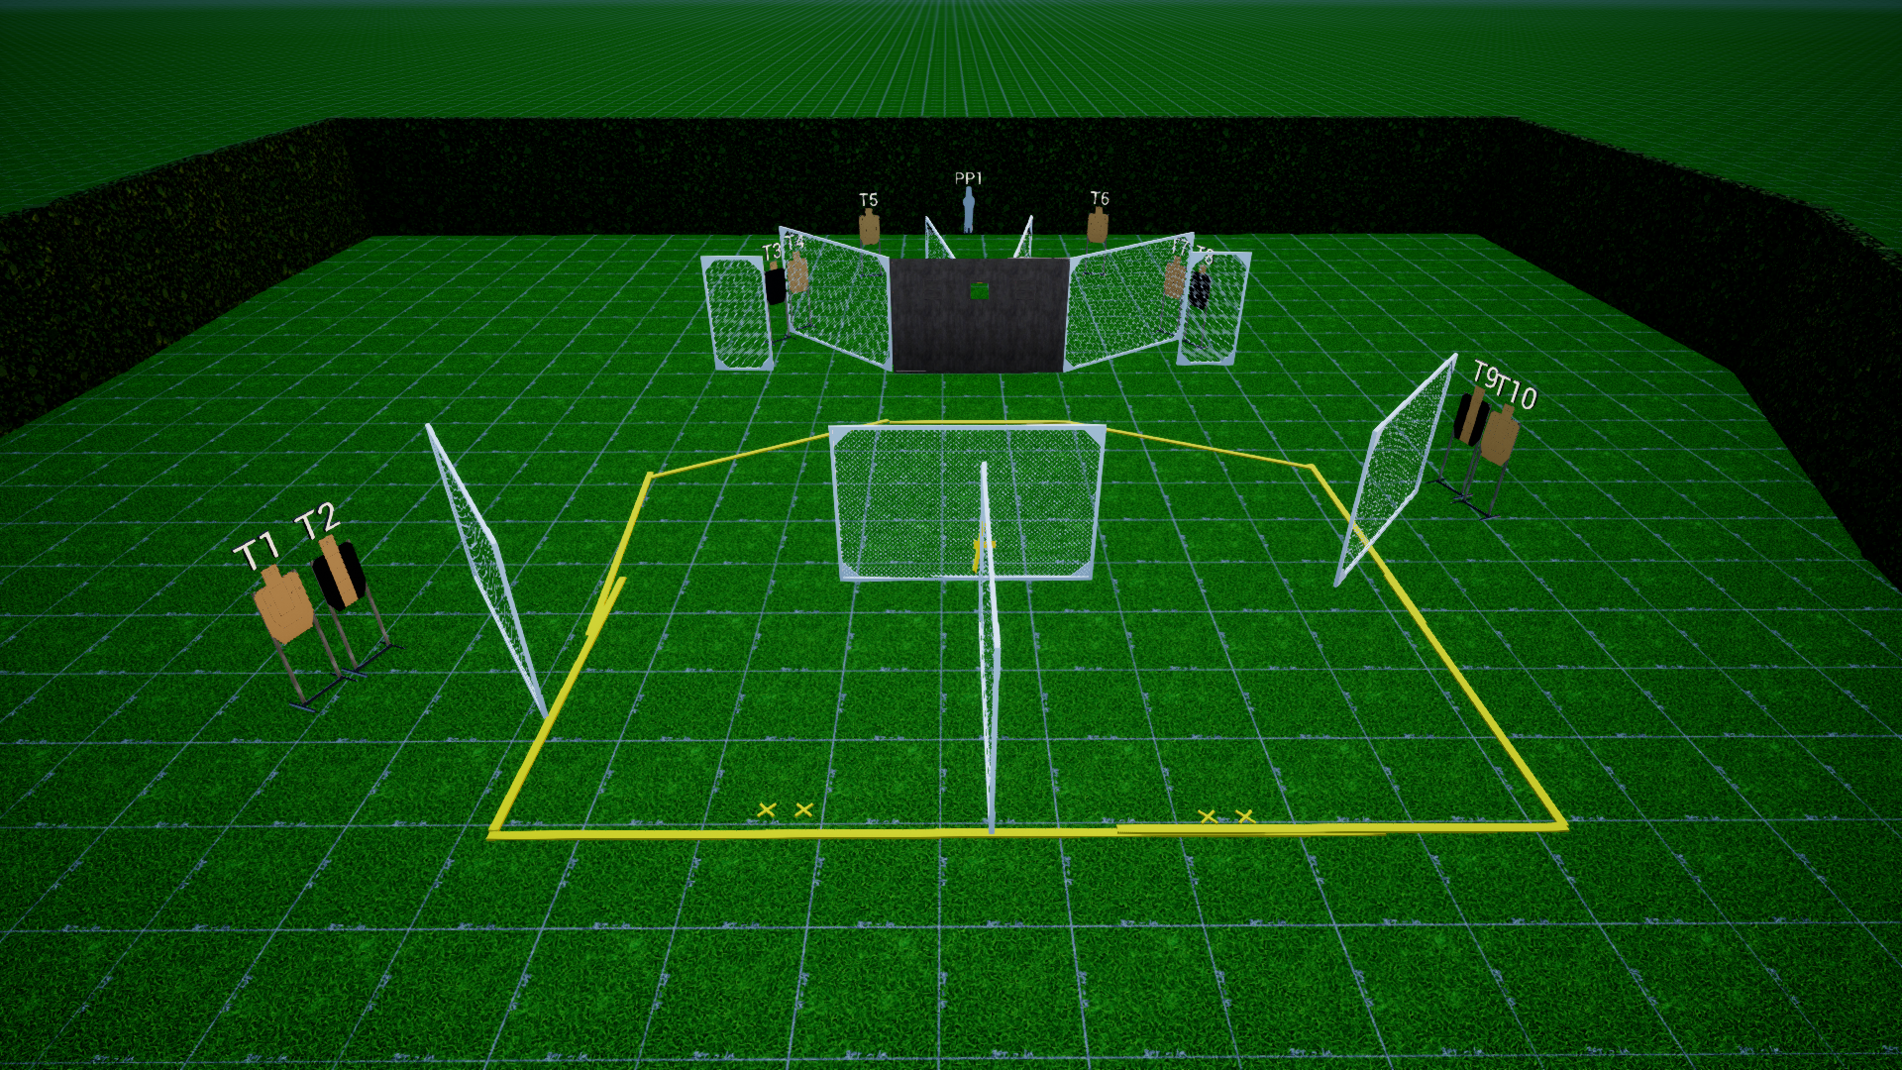
 | Stage 1 A Tale of Three Three Windows Course Designer: Marcel Englmaier

Slide 4
Stage 2 The Polish Do It Like This Course Designer: Marcel Englmaier
The Polish Do It Like This is a 12 round, 60 point Comstock Medium course. There are 5 USPSA targets and 3 steel targets. The best two hits per target will score. Steel must fall to score. The start signal is audible.
The Handgun start position is standing with heels touching marks and wrists below belt. Handgun unloaded and holstered. The PCC start position is standing with heels touching marks. PCC unloaded with stock touching belt and muzzle pointed down range. Both hands holding PCC.
On the audible start signal, engage all targets from within the shooting area. PP1 activates bobber which is visible at rest. PP2 activates swinger which is visible at rest.

Slide 5
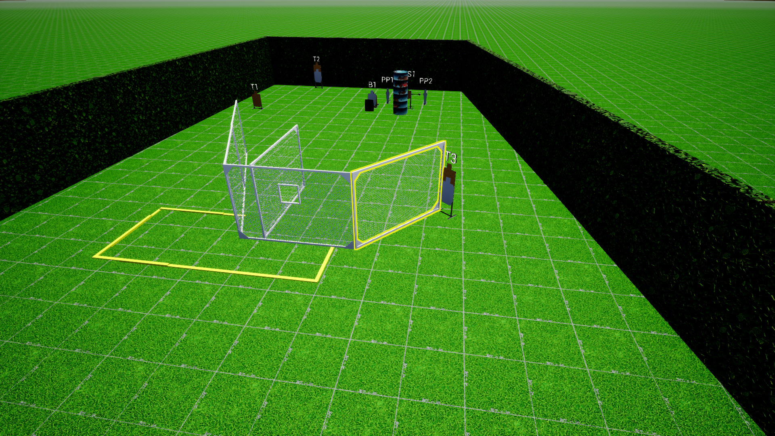
 | Stage 2 The Polish Do It Like This Course Designer: Marcel Englmaier

Slide 6
Stage 3 A Barrel a Day Course Designer: Jordan Rogers
A Barrel a Day is a 23 round, 115 point Comstock long course. There are 10 USPSA targets and 3 steel targets. The best two hits per target will score. Steel must fall to score. The start signal is audible.
The Handgun start position is handgun unloaded, lying flat and unsupported on barrel. Hands must be touching the X’s on the front walls. The PCC start position is PCC unloaded, lying flat and unsupported on barrel. Hands must be touching the X’s on the front walls.
On the audible start signal, engage targets as visible from within the shooting area.

Slide 7
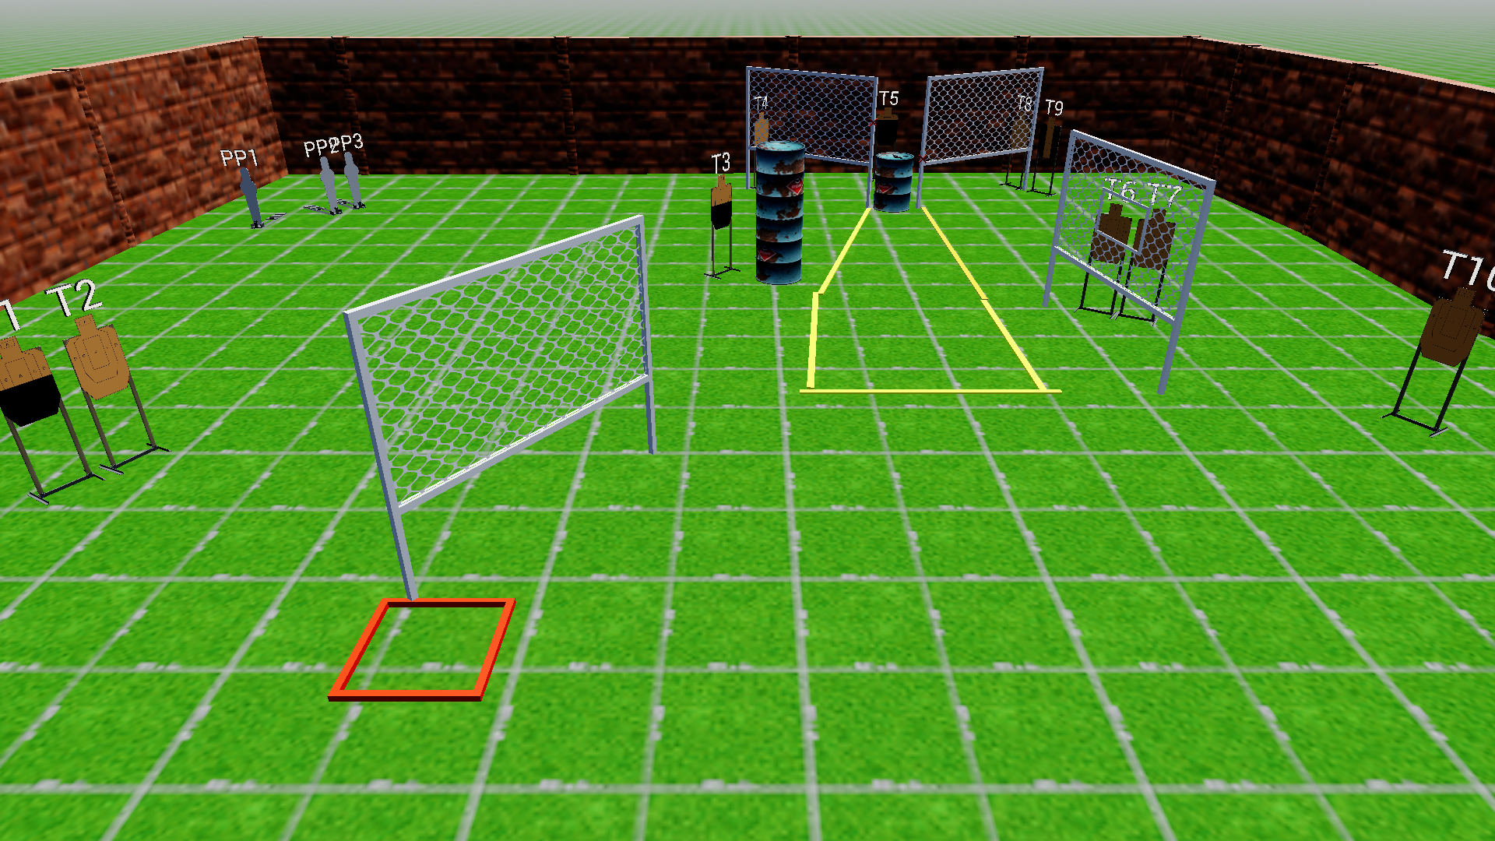
 | Stage 3 A Barrel a Day Course Designer: Jordan Rogers

Slide 8
Stage 4 Not Fair, Don’t Care Course Designer: Chris Pukalo
Not Fair, Don’t Care is a 22 round, 110 point Comstock Long course. There are 22 USPSA targets. The best two hits per target will score. The start signal is audible.
The Handgun start position is standing with toes touching either set of marks and wrists below belt. Handgun loaded and holstered. The PCC start position is standing with toes touching either set of marks. PCC loaded with stock touching belt and muzzle pointed down range.
On the audible start signal, engage all targets from within the shooting area.

Slide 9
 | Stage 4 Not Fair, Don’t Care Course Designer: Chris Pukalo
xx
xx

Slide 10
Stage 5 Our Lady of Blessed Acceleration Course Designer: Eric Beerbaum
Our Lady of Blessed Acceleration is a 16 round, 80 point Comstock medium course. There are 8 USPSA targets. Box A is NOT a shooting area. The best two hits per target will score. The start signal is audible.
The Handgun start position is standing in box A, handgun loaded and holstered, wrists below belt. The PCC start position is standing in box A, PCC loaded, stock on belt, muzzle pointing at back berm.
On the audible start signal, engage all targets from within the shooting areas.

Slide 11
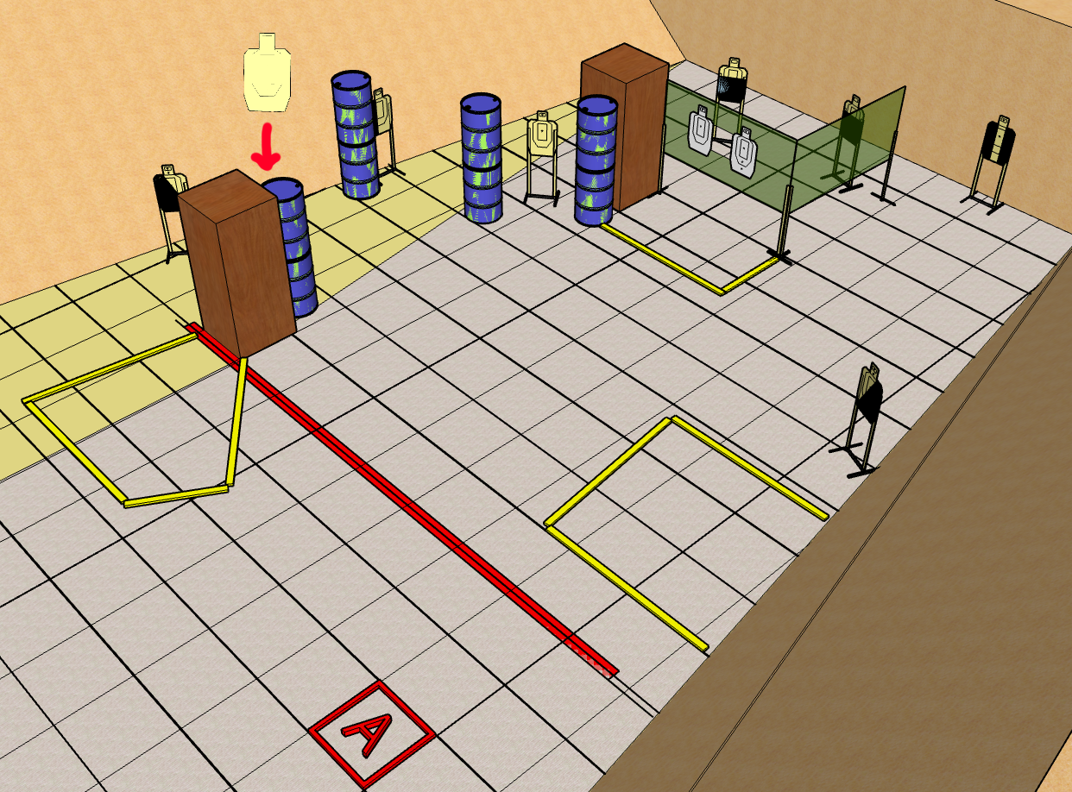
 | Stage 5 Our Lady of Blessed Acceleration Course Designer: Eric Beerbaum

Slide 12
Stage 6 Wall Sits Course Designer: Jordan Rogers
Wall Sits is a 20 round, 100 point comstock medium course. There are 10 USPSA targets. The best two hits per target will score. The start signal is audible.
The Handgun start position is standing outside the 3x3 shooting box with back touching the tree guard and toes touching the shooting box. Handguard is loaded and holstered. The PCC start position is standing outside the 3x3 shooting box with back touching the tree guard and toes touching the shooting box. PCC is loaded with stock on belt and muzzle pointed downrange.
On the audible start signal, engage targets as visible from within the shooting area.

Slide 13
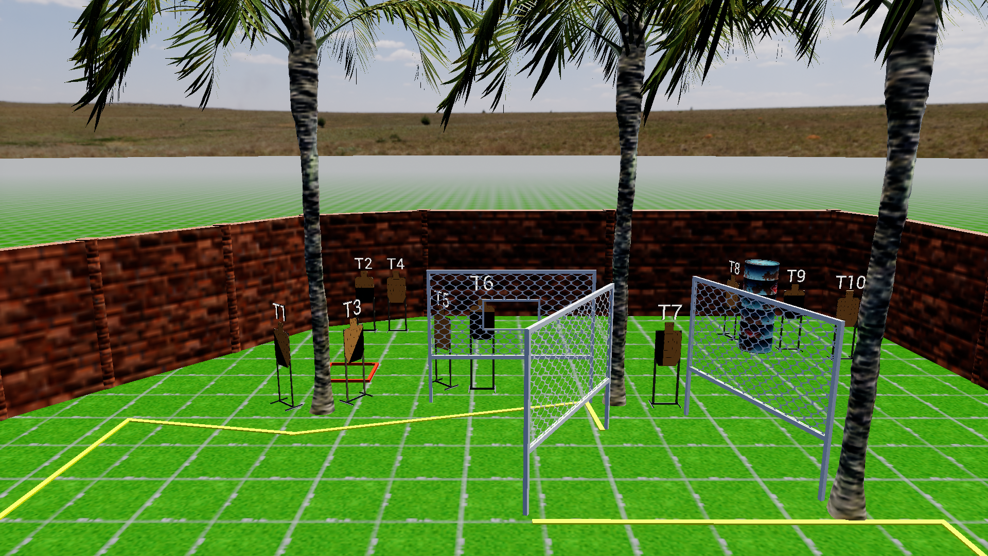
 | Stage 6 Wall Sits Course Designer: Jordan Rogers

Slide 14
Stage 7: Classifier of some form

